Slide 1
Chapter 3 Selections

Slide 2
Motivations
If you assigned a negative value for radius in Listing 2.2, ComputeAreaWithConsoleInput.java, the program would print an invalid result. If the radius is negative, you don't want the program to compute the area. How can you deal with this situation?

Slide 3
Objectives
To declare boolean variables and write Boolean expressions using relational operators (§3.2).
To implement selection control using one-way if statements (§3.3).
To implement selection control using two-way if-else statements (§3.4).
To implement selection control using nested if and multi-way if statements (§3.5).
To avoid common errors and pitfalls in if statements (§3.6).
To generate random numbers using the Math.random() method (§3.7).
To program using selection statements for a variety of examples (SubtractionQuiz, BMI, ComputeTax) (§§3.7–3.9).
To combine conditions using logical operators (&&, ||, and !) (§3.10).
To program using selection statements with combined conditions (LeapYear, Lottery) (§§3.11–3.12).
To implement selection control using switch statements (§3.13).
To write expressions using the conditional expression (§3.14).
To examine the rules governing operator precedence and associativity (§3.15).
To apply common techniques to debug errors (§3.16).

Slide 4
The boolean Type and Operators
Often in a program you need to compare two values, such as whether i is greater than j. Java provides six comparison operators (also known as relational operators) that can be used to compare two values. The result of the comparison is a Boolean value: true or false.
boolean b = (1 > 2);

Slide 5
Relational Operators

Slide 6
Problem: A Simple Math Learning Tool
This example creates a program to let a first grader practice additions. The program randomly generates two single-digit integers number1 and number2 and displays a question such as “What is 7 + 9?” to the student. After the student types the answer, the program displays a message to indicate whether the answer is true or false.
IMPORTANT NOTE: If you cannot run the buttons, see liveexample.pearsoncmg.com/slide/javaslidenote.doc.
AdditionQuiz
Run

Slide 7
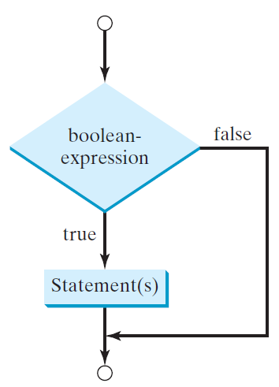
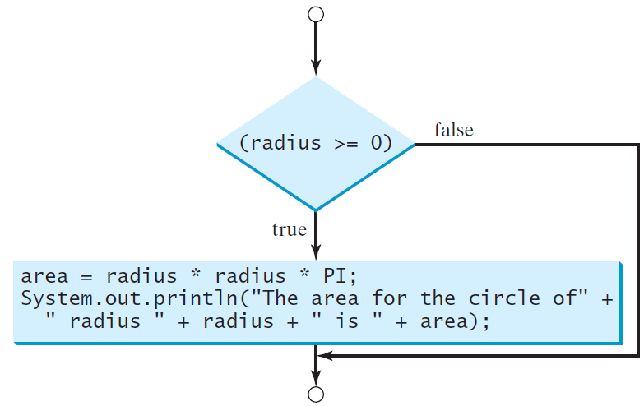
One-way if Statements
if (radius >= 0) {
area = radius * radius * PI;
System.out.println("The area"
+ " for the circle of radius "
+ radius + " is " + area);
}
if (boolean-expression) {
statement(s);
}

Slide 8
Note

Slide 9
☑ Check Point
List six relational operators.
<--- ANSWER --->
<, <=, ==, !=, >, >=

Slide 10
☑ Check Point
Assuming that x is 1, show the result of the following Boolean expressions: x > 0 x < 0 x != 0 x >= 0 x != 1
<--- ANSWER --->
true false true true false

Slide 11
☑ Check Point
Can the following conversions involving casting be allowed? Write a test program to verify it. boolean b = true; i = (int)b; int i = 1; boolean b = (boolean)i;
<--- ANSWER --->
No. Boolean values cannot be cast to other types.

Slide 12
Simple if Demo
Write a program that prompts the user to enter an integer. If the number is a multiple of 5, print HiFive. If the number is divisible by 2, print HiEven.
SimpleIfDemo
Run

Slide 13
☑ Check Point
Write an if statement that assigns 1 to x if y is greater than 0.
Write an if statement that increases pay by 3% if score is greater than 90.
<--- ANSWER --->
if (y > 0) x = 1;
if (score > 90) pay *= 1.03;

Slide 14
☑ Check Point
What is wrong in the following code? if radius >= 0 { area = radius * radius * PI; System.out.println("The area for the circle of " + " radius " + radius + " is " + area); }
<--- ANSWER --->
The parentheses is required for the condition radius >= 0.

Slide 15
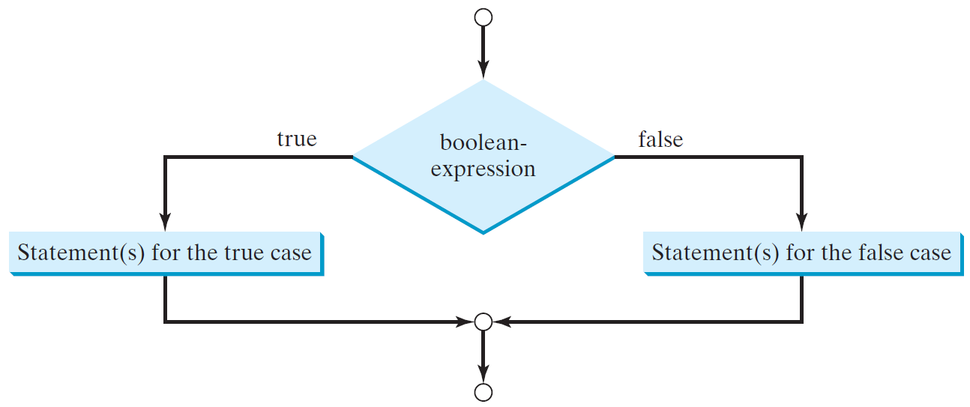
The Two-way if Statement
if (boolean-expression) {
statement(s)-for-the-true-case;
}
else {
statement(s)-for-the-false-case;
}

Slide 16
if-else Example
if (radius >= 0) {
area = radius * radius * 3.14159;
System.out.println("The area for the “
+ “circle of radius " + radius +
" is " + area);
}
else {
System.out.println("Negative input");
}

Slide 17
☑ Check Point
Write an if statement that increases pay by 3% if score is greater than 90, otherwise increases pay by 1%.
<--- ANSWER --->
if (score > 90) pay *= 1.03; else pay *= 1.01;

Slide 18
☑ Check Point
What is the output of the code in (a) and (b) if number is 30? What if number is 35? (a) if (number % 2 == 0) System.out.println(number + " is even."); System.out.println(number + " is odd."); (b) if (number % 2 == 0) System.out.println(number + " is even."); else System.out.println(number + " is odd.");
<--- ANSWER --->
If number is 30, (a) displays (b) displays 30 is even 30 is even 30 is odd If number is 35, (a) displays (b) displays 35 is odd 35 is odd

Slide 19
Multiple Alternative if Statements

Slide 20
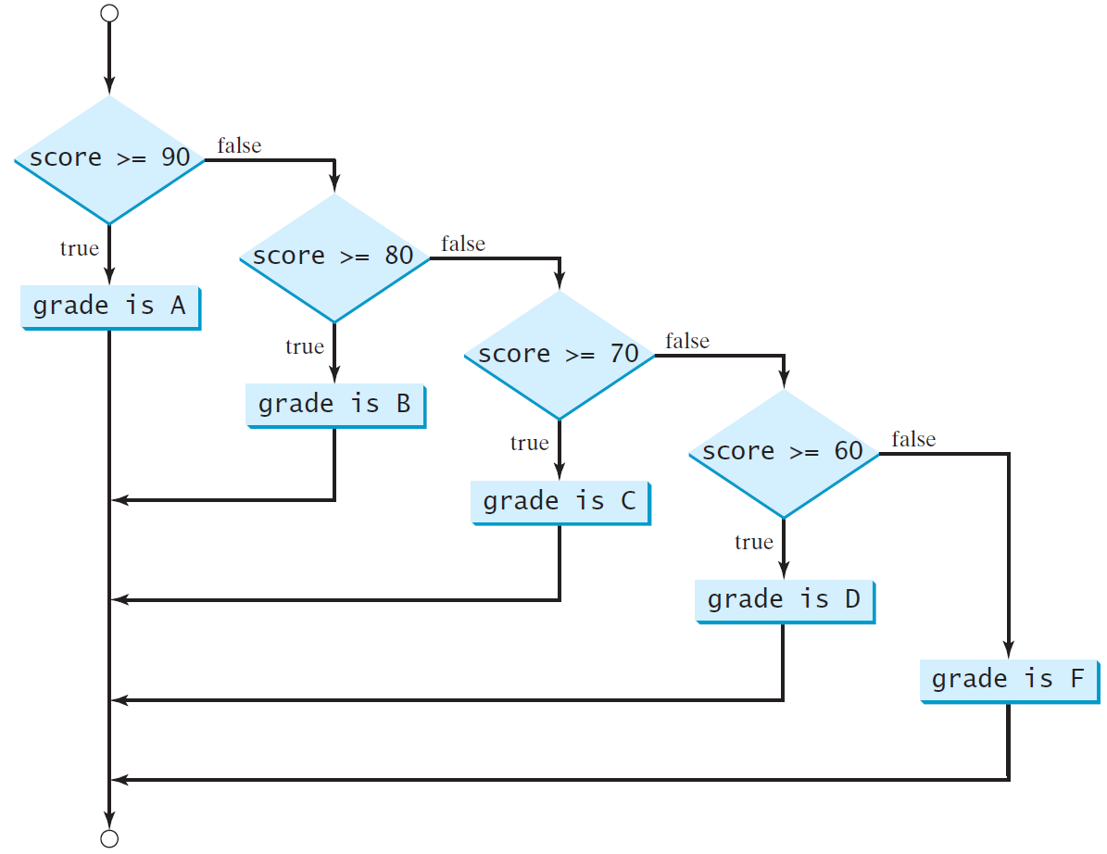
Multi-Way if-else Statements

Slide 21
Trace if-else statement
animation
Suppose score is 70.0
The condition is false
if (score >= 90.0)
System.out.print("A");
else if (score >= 80.0)
System.out.print("B");
else if (score >= 70.0)
System.out.print("C");
else if (score >= 60.0)
System.out.print("D");
else
System.out.print("F");

Slide 22
Trace if-else statement
animation
Suppose score is 70.0
The condition is false
if (score >= 90.0)
System.out.print("A");
else if (score >= 80.0)
System.out.print("B");
else if (score >= 70.0)
System.out.print("C");
else if (score >= 60.0)
System.out.print("D");
else
System.out.print("F");

Slide 23
Trace if-else statement
animation
Suppose score is 70.0
The condition is true
if (score >= 90.0)
System.out.print("A");
else if (score >= 80.0)
System.out.print("B");
else if (score >= 70.0)
System.out.print("C");
else if (score >= 60.0)
System.out.print("D");
else
System.out.print("F");

Slide 24
Trace if-else statement
animation
Suppose score is 70.0
grade is C
if (score >= 90.0)
System.out.print("A");
else if (score >= 80.0)
System.out.print("B");
else if (score >= 70.0)
System.out.print("C");
else if (score >= 60.0)
System.out.print("D");
else
System.out.print("F");

Slide 25
Trace if-else statement
animation
Suppose score is 70.0
Exit the if statement
if (score >= 90.0)
System.out.print("A");
else if (score >= 80.0)
System.out.print("B");
else if (score >= 70.0)
System.out.print("C");
else if (score >= 60.0)
System.out.print("D");
else
System.out.print("F");

Slide 26
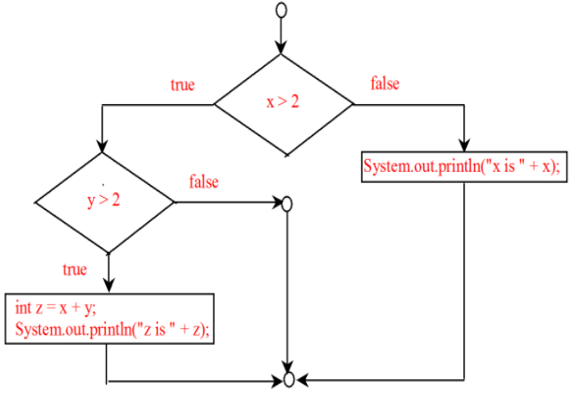
☑ Check Point
Suppose x = 3 and y = 2; show the output, if any, of the following code. What is the output if x = 3 and y = 4? What is the output if x = 2 and y = 2? Draw a flowchart of the code. if (x > 2) { if (y > 2) { z = x + y; System.out.println("z is " + z); } } else System.out.println("x is " + x);
<--- ANSWER --->
Note: else matches the first if clause. No output if x = 3 and y = 2. Output is "z is 7" if if x = 3 and y = 4. Output is "x is 2" if if x = 2 and y = 2.

Slide 27
☑ Check Point
Suppose x = 2 and y = 3. Show the output, if any, of the following code. What is the output if x = 3 and y = 2? What is the output if x = 3 and y = 3? if (x > 2) if (y > 2) { int z = x + y; System.out.println("z is " + z); } else System.out.println("x is " + x);
<--- ANSWER --->
Note that the else pairs with the most recent if. In this case, the else pairs with the second else. So, the code is same as if (x > 2) if (x > 2) { if (y > 2) { if (y > 2) { int z = x + y; int z = x + y; System.out.println("z is " + z); System.out.println("z is " + z); } } else else System.out.println("x is " + x); System.out.println("x is " + x); } No output if x = 2 and y = 3. Output is "x is 3" if x = 3 and y = 2. Output is "z is 6" if x = 3 and y = 3.

Slide 28
☑ Check Point
What is wrong in the following code? if (score >= 60.0) System.out.println("D"); else if (score >= 70.0) System.out.println("C"); else if (score >= 80.0) System.out.println("B"); else if (score >= 90.0) System.out.println("A"); else System.out.println("F");
<--- ANSWER --->
Consider score 90, what will be the grade? It will be D.

Slide 29
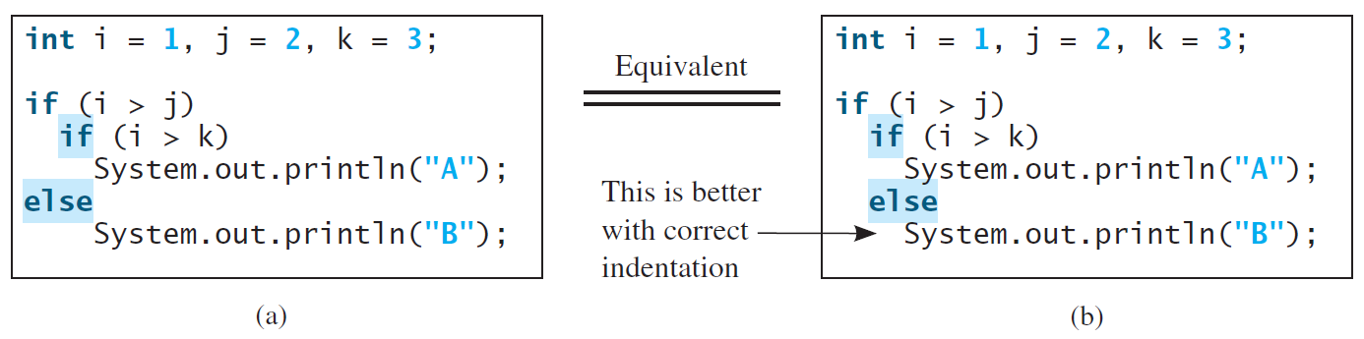
Note
The else clause matches the most recent if clause in the same block.

Slide 30
Note, cont.
Nothing is printed from the preceding statement. To force the else clause to match the first if clause, you must add a pair of braces:
int i = 1;
int j = 2;
int k = 3;
if (i > j) {
if (i > k)
System.out.println("A");
}
else
System.out.println("B");
This statement prints B.

Slide 31
Common Errors
Adding a semicolon at the end of an if clause is a common mistake.
if (radius >= 0);
{
area = radius*radius*PI;
System.out.println(
"The area for the circle of radius " +
radius + " is " + area);
}
This mistake is hard to find, because it is not a compilation error or a runtime error, it is a logic error.
This error often occurs when you use the next-line block style.
Wrong

Slide 32
TIP

Slide 33
CAUTION

Slide 34
☑ Check Point
Which of the following statements are equivalent? Which ones are correctly indented? (a) if (i > 0) if (b) if (i > 0) { (j > 0) if (j > 0) x = 0; else x = 0; if (k > 0) y = 0; else if (k > 0) else z = 0; y = 0; } else z = 0; (c) if (i > 0) (d) if (i > 0) if (j > 0) if (j > 0) x = 0; x = 0; else if (k > 0) else if (k > 0) y = 0; y = 0; else else z = 0; z = 0;
<--- ANSWER --->
a, c, and d are the same. (b) and (c) are correctly indented.

Slide 35
☑ Check Point
Rewrite the following statement using a Boolean expression: if (count % 10 == 0) newLine = true; else newLine = false;
<--- ANSWER --->
newLine = (count % 10 == 0);

Slide 36
☑ Check Point
Are the following statements correct? Which one is better? (a) if (age < 16) System.out.println ("Cannot get a driver's license"); if (age >= 16) System.out.println ("Can get a driver's license"); (b) if (age < 16) System.out.println ("Cannot get a driver's license"); else System.out.println ("Can get a driver's license");
<--- ANSWER --->
Both are correct. (b) is better.

Slide 37
☑ Check Point
What is the output of the following code if number is 14, 15, or 30? (a) (b) if (number % 2 == 0) if (number % 2 == 0) System.out.println System.out.println (number + " is even"); (number + " is even"); if (number % 5 == 0) else if (number % 5 == 0) System.out.println System.out.println (number + " is multiple of 5"); (number + " is multiple of 5");
<--- ANSWER --->
For (a) if number is 14, the output is -> 14 is even if number is 15, the output is -> 15 is multiple of 5 if number is 30, the output is -> 30 is even 30 is multiple of 5 For (b) if number is 14, the output is -> 14 is even If number is 15, the output is -> 15 is multiple of 5 if number is 30, the output is -> 30 is even

Slide 38
Problem: An Improved Math Learning Tool
This example creates a program to teach a first grade child how to learn subtractions. The program randomly generates two single-digit integers number1 and number2 with number1 >= number2 and displays a question such as “What is 9 – 2?” to the student. After the student types the answer, the program displays whether the answer is correct.
SubtractionQuiz
Run

Slide 39
☑ Check Point
Which of the following is a possible output from invoking Math.random()? 323.4, 0.5, 34, 1.0, 0.0, 0.234
<--- ANSWER --->
0.5, 0.0, 0.234

Slide 40
☑ Check Point
How do you generate a random integer i such that 0 <= i < 20 ?
How do you generate a random integer i such that 10 <= i < 20 ?
How do you generate a random integer i such that 10 <= i <= 50 ?
Write an expression that returns 0 or 1 randomly.
<--- ANSWER --->
(int)(Math.random() * 20)
10 + (int)(Math.random() * 10)
10 + (int)(Math.random() * 41)
(int)(Math.random() * 2)

Slide 41
Problem: Body Mass Index
Body Mass Index (BMI) is a measure of health on weight. It can be calculated by taking your weight in kilograms and dividing by the square of your height in meters. The interpretation of BMI for people 16 years or older is as follows:
ComputeAndInterpretBMI
Run

Slide 42
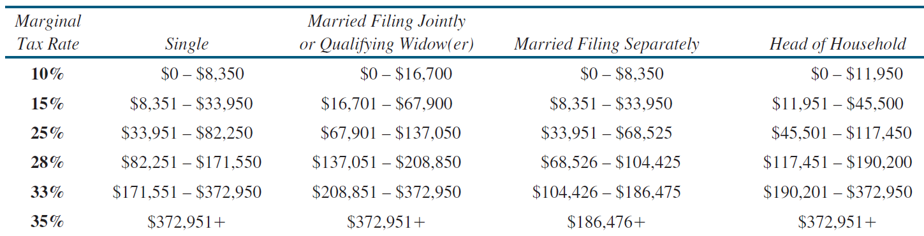
Problem: Computing Taxes
The US federal personal income tax is calculated based on the filing status and taxable income. There are four filing statuses: single filers, married filing jointly, married filing separately, and head of household. The tax rates for 2009 are shown below.

Slide 43
Problem: Computing Taxes, cont.
if (status == 0) {
// Compute tax for single filers
}
else if (status == 1) {
// Compute tax for married file jointly
// or qualifying widow(er)
}
else if (status == 2) {
// Compute tax for married file separately
}
else if (status == 3) {
// Compute tax for head of household
}
else {
// Display wrong status
}
ComputeTax
Run

Slide 44
☑ Check Point
Are the following two statements equivalent? (a) if (income <= 10000) tax = income * 0.1; else if (income <= 20000) tax = 1000 + (income - 10000) * 0.15; (b) if (income <= 10000) tax = income * 0.1; else if (income > 10000 && income <= 20000) tax = 1000 + (income - 10000) * 0.15;
<--- ANSWER --->
Yes

Slide 45
Logical Operators
Operator | Name | Description
! | not | logical negation
&& | and | logical conjunction
|| | or | logical disjunction
^ | exclusive or | logical exclusion

Slide 46
Truth Table for Operator !
p | !p | Example (assume age = 24, weight = 140)
true | false | !(age > 18) is false, because (age > 18) is true.
false | true | !(weight == 150) is true, because (weight == 150) is false.

Slide 47
Truth Table for Operator &&
p₁ | p₂ | p₁ && p₂ | Example (assume age = 24, weight = 140)
false | false | false | (age <= 18) && (weight < 140) is false, because both conditions are false.
false | true | false | (age <= 18) && (weight > 140) is false, because (age <= 18) is false.
true | false | false | (age > 18) && (weight > 140) is false, because (weight > 140) is false.
true | true | true | (age > 18) && (weight >= 140) is true, because both (age > 18) and (weight >= 140) are true.

Slide 48
Truth Table for Operator ||
p₁ | p₂ | p₁ || p₂ | Example (assume age = 24, weight = 140)
false | false | false
false | true | true | (age > 34) || (weight <= 140) is true, because (weight <= 140) is true.
true | false | true | (age > 14) || (weight >= 150) is false, because (age > 14) is true.
true | true | true

Slide 49
Truth Table for Operator ^
p₁ | p₂ | p₁ ^ p₂ | Example (assume age = 24, weight = 140)
false | false | false | (age > 34) ^ (weight > 140) is false, because both (age > 34) and (weight > 140) is false.
false | true | true | (age > 34) ^ (weight >= 140) is true, because (age > 34) is false but (weight >= 140) is true.
true | false | true | (age > 14) ^ (weight > 140) is true, because (age > 14) is true and (weight > 140) is false.
true | true | false

Slide 50
Examples
Here is a program that checks whether a number is divisible by 2 and 3, whether a number is divisible by 2 or 3, and whether a number is divisible by 2 or 3 but not both:
TestBooleanOperators
Run

Slide 51
Examples
System.out.println("Is " + number + " divisible by 2 and 3? " +
((number % 2 == 0) && (number % 3 == 0)));
System.out.println("Is " + number + " divisible by 2 or 3? " +
((number % 2 == 0) || (number % 3 == 0)));
System.out.println("Is " + number +
" divisible by 2 or 3, but not both? " +
((number % 2 == 0) ^ (number % 3 == 0)));
TestBooleanOperators
Run

Slide 52
The & and | Operators
Companion Website
Supplement III.B, “The & and | Operators”

Slide 53
The & and | Operators
Companion Website
If x is 1, what is x after this expression?
(x > 1) & (x++ < 10)
If x is 1, what is x after this expression?
(1 > x) && ( 1 > x++)
How about (1 == x) | (10 > x++)?
(1 == x) || (10 > x++)?

Slide 54
☑ Check Point
Assuming that x is 1, show the result of the following Boolean expressions. (true) && (3 > 4) !(x > 0) && (x > 0) (x > 0) || (x < 0) (x != 0) || (x == 0) (x >= 0) || (x < 0) (x != 1) == !(x == 1)
<--- ANSWER --->
(true) && (3 > 4) is false !(x > 0) && (x > 0) is false (x > 0) || (x < 0) is true (x != 0) || (x == 0) is true (x >= 0) || (x < 0) is true (x != 1) == !(x == 1) is true

Slide 55
☑ Check Point
Write a Boolean expression that evaluates to true if a number stored in variable num is between 1 and 100.
Write a Boolean expression that evaluates to true if a number stored in variable num is between 1 and 100 or the number is negative.
<--- ANSWER --->
(num > 1) && (num < 100)
(num > 1) && (num < 100) || num < 0

Slide 56
☑ Check Point
Write a Boolean expression for |x - 5| < 4.5.
Write a Boolean expression for |x - 5| > 4.5.
<--- ANSWER --->
(x - 5) < 4.5 && (x - 5) > -4.5
(x - 5) > 4.5 || (x - 5) < -4.5

Slide 57
☑ Check Point
Assume that x and y are int type. Which of the following are legal Java expressions? x > y > 0 x = y && y x /= y x or y x and y (x != 0) || (x = 0)
<--- ANSWER --->
x > y > 0 is incorrect x = y && y is incorrect x /= y is correct x or y is incorrect x and y is incorrect (x != 0) || (x = 0) is incorrect on x = 0. It should be x == 0.

Slide 58
☑ Check Point
Are the following two expressions the same? (a) x % 2 == 0 && x % 3 == 0 (b) x % 6 == 0
<--- ANSWER --->
Yes

Slide 59
☑ Check Point
What is the value of the expression x >= 50 && x <= 100 if x is 45, 67, or 101?
<--- ANSWER --->
If x is 45, the expression is false. If x is 67, the expression is true. If x is 101, the expression is false.

Slide 60
☑ Check Point
Suppose, when you run the following program, you enter the input 2 3 6 from the console. What is the output? public class Test { public static void main(String[] args) { java.util.Scanner input = new java.util.Scanner(System.in); double x = input.nextDouble(); double y = input.nextDouble(); double z = input.nextDouble(); System.out.println("(x < y && y < z) is " + (x < y && y < z)); System.out.println("(x < y || y < z) is " + (x < y || y < z)); System.out.println("!(x < y) is " + !(x < y)); System.out.println("(x + y < z) is " + (x + y < z)); System.out.println("(x + y > z) is " + (x + y > z)); } }
<--- ANSWER --->
(x < y && y < z) is true (x < y || y < z) is true !(x < y) is false (x + y < z) is true (x + y > z) is false

Slide 61
☑ Check Point
Write a Boolean expression that evaluates to true if age is greater than 13 and less than 18.
Write a Boolean expression that evaluates to true if weight is greater than 50 pounds or height is greater than 60 inches.
Write a Boolean expression that evaluates to true if weight is greater than 50 pounds and height is greater than 60 inches.
Write a Boolean expression that evaluates to true if either weight is greater than 50 pounds or height is greater than 60 inches, but not both.
<--- ANSWER --->
age > 13 && age < 18
weight > 50 || height > 60
weight > 50 && height > 60
weight > 50 ^ height > 60

Slide 62
Problem: Determining Leap Year?
This program first prompts the user to enter a year as an int value and checks if it is a leap year.
A year is a leap year if it is divisible by 4 but not by 100, or it is divisible by 400.
(year % 4 == 0 && year % 100 != 0) || (year % 400 == 0)
LeapYear
Run

Slide 63
☑ Check Point
How many days in the February of a leap year?
Which of the following is a leap year? 500, 1000, 2000, 2016, and 2020?
<--- ANSWER --->
29 days.
500, 1000 are not leap years. 2000, 2016, and 2020 are leap years.

Slide 64
Problem: Lottery
Write a program that randomly generates a lottery of a two-digit number, prompts the user to enter a two-digit number, and determines whether the user wins according to the following rule:
If the user input matches the lottery in exact order, the award is $10,000.
If the user input matches the lottery, the award is $3,000.
If one digit in the user input matches a digit in the lottery, the award is $1,000.
Lottery
Run

Slide 65
☑ Check Point
What happens if you enter an integer as 05?
<--- ANSWER --->
It will be the same as entering 5.

Slide 66
switch Statements
switch (status) {
case 0: compute taxes for single filers;
break;
case 1: compute taxes for married file jointly;
break;
case 2: compute taxes for married file separately;
break;
case 3: compute taxes for head of household;
break;
default: System.out.println("Errors: invalid status");
System.exit(1);
}

Slide 67
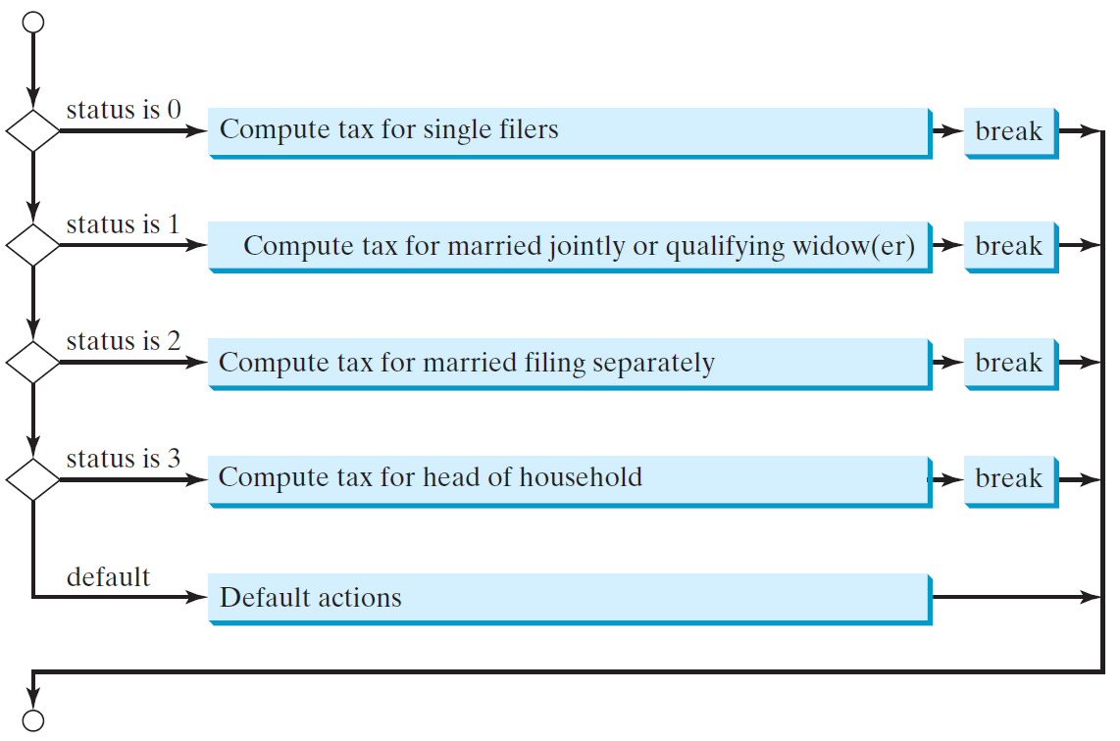
switch Statement Flow Chart

Slide 68
switch Statement Rules
The switch-expression must yield a value of char, byte, short, or int type and must always be enclosed in parentheses.
switch (switch-expression) {
case value1: statement(s)1;
break;
case value2: statement(s)2;
break;
…
case valueN: statement(s)N;
break;
default: statement(s)-for-default;
}
The value1, ..., and valueN must have the same data type as the value of the switch-expression. The resulting statements in the case statement are executed when the value in the case statement matches the value of the switch-expression. Note that value1, ..., and valueN are constant expressions, meaning that they cannot contain variables in the expression, such as 1 + x.

Slide 69
switch Statement Rules
The keyword break is optional, but it should be used at the end of each case in order to terminate the remainder of the switch statement. If the break statement is not present, the next case statement will be executed.
switch (switch-expression) {
case value1: statement(s)1;
break;
case value2: statement(s)2;
break;
…
case valueN: statement(s)N;
break;
default: statement(s)-for-default;
}
The default case, which is optional, can be used to perform actions when none of the specified cases matches the switch-expression.
When the value in a case statement matches the value of the switch-expression, the statements starting from this case are executed until either a break statement or the end of the switch statement is reached.

Slide 70
Trace switch statement
animation
Suppose day is 2:
switch (day) {
case 1:
case 2:
case 3:
case 4:
case 5: System.out.println("Weekday"); break;
case 0:
case 6: System.out.println("Weekend");
}

Slide 71
Trace switch statement
animation
Match case 2
switch (day) {
case 1:
case 2:
case 3:
case 4:
case 5: System.out.println("Weekday"); break;
case 0:
case 6: System.out.println("Weekend");
}

Slide 72
Trace switch statement
animation
Fall through case 3
switch (day) {
case 1:
case 2:
case 3:
case 4:
case 5: System.out.println("Weekday"); break;
case 0:
case 6: System.out.println("Weekend");
}

Slide 73
Trace switch statement
animation
Fall through case 4
switch (day) {
case 1:
case 2:
case 3:
case 4:
case 5: System.out.println("Weekday"); break;
case 0:
case 6: System.out.println("Weekend");
}

Slide 74
Trace switch statement
animation
Fall through case 5
switch (day) {
case 1:
case 2:
case 3:
case 4:
case 5: System.out.println("Weekday"); break;
case 0:
case 6: System.out.println("Weekend");
}

Slide 75
Trace switch statement
animation
Encounter break
switch (day) {
case 1:
case 2:
case 3:
case 4:
case 5: System.out.println("Weekday"); break;
case 0:
case 6: System.out.println("Weekend");
}

Slide 76
Trace switch statement
animation
Exit the statement
switch (day) {
case 1:
case 2:
case 3:
case 4:
case 5: System.out.println("Weekday"); break;
case 0:
case 6: System.out.println("Weekend");
}

Slide 77
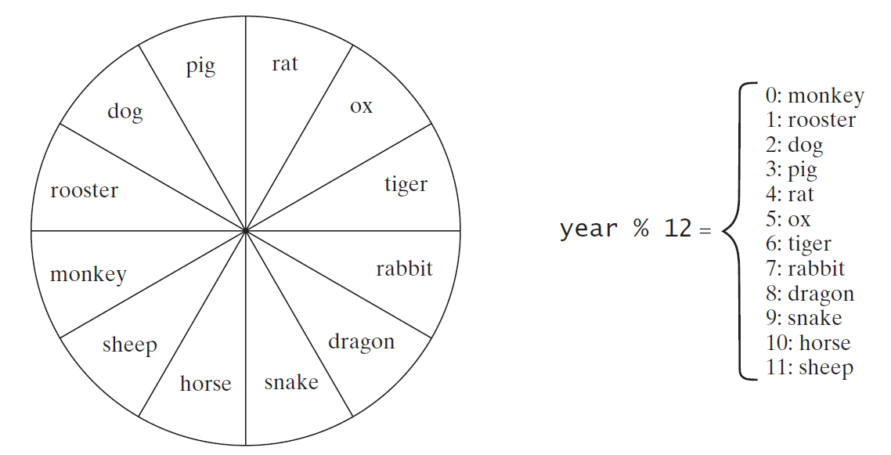
Problem: Chinese Zodiac
Write a program that prompts the user to enter a year and displays the animal for the year.
ChineseZodiac
Run

Slide 78
☑ Check Point
What data types are required for a switch variable?
If the keyword break is not used after a case is processed, what is the next statement to be executed?
Can you convert a switch statement to an equivalent if statement, or vice versa?
What are the advantages of using a switch statement?
<--- ANSWER --->
Switch variables must be of char, byte, short, int, or String types.
If a break statement is not used, the next case statement is performed.
You can always convert a switch statement to an equivalent if statement, but not an if statement to a switch statement.
The use of the switch statement can improve readability of the program in some cases. The compiled code for the switch statement is also more efficient than its corresponding if statement.

Slide 79
☑ Check Point
What is y after the following switch statement is executed? Rewrite the code using an if-else statement. x = 3; y = 3; switch (x + 3) { case 6: y = 1; default: y += 1; }
<--- ANSWER --->
y is 2. x = 3; y = 3; if (x + 3 == 6) { y = 1; } y += 1;

Slide 80
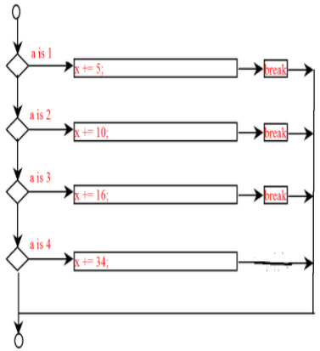
☑ Check Point
What is x after the following if-else statement is executed? Use a switch statement to rewrite it and draw the flowchart for the new switch statement. int x = 1, a = 3; if (a == 1) x += 5; else if (a == 2) x += 10; else if (a == 3) x += 16; else if (a == 4) x += 34;
<--- ANSWER --->
x is 17 switch (a) { case 1: x += 5; break; case 2: x += 10; break; case 3: x += 16; break; case 4: x += 34; }

Slide 81
☑ Check Point
Write a switch statement that displays Sunday, Monday, Tuesday, Wednesday, Thursday, Friday, Saturday, if day is 0, 1, 2, 3, 4, 5, 6, accordingly.
<--- ANSWER --->
switch (day) { case 0: System.out.println("Sunday"); break; case 1: System.out.println("Monday"); break; case 2: System.out.println("Tuesday"); break; case 3: System.out.println("Wednesday"); break; case 4: System.out.println("Thurday"); break; case 5: System.out.println("Friday"); break; case 6: System.out.println("Saturday"); break; }

Slide 82
☑ Check Point
Rewrite the following switch statement using an if-else statement. switch (year % 12) { case 0: System.out.println("monkey"); break; case 1: System.out.println("rooster"); break; case 2: System.out.println("dog"); break; case 3: System.out.println("pig"); break; case 4: System.out.println("rat"); break; case 5: System.out.println("ox"); break; case 6: System.out.println("tiger"); break; case 7: System.out.println("rabbit"); break; case 8: System.out.println("dragon"); break; case 9: System.out.println("snake"); break; case 10: System.out.println("horse"); break; case 11: System.out.println("sheep"); }
<--- ANSWER --->
int remainder = year % 12; if (remainder == 0) System.out.println("monkey"); else if (remainder == 1) System.out.println("rooster"); else if (remainder == 2) System.out.println("dog"); else if (remainder == 3) System.out.println("pig"); else if (remainder == 4) System.out.println("rat"); else if (remainder == 5) System.out.println("ox"); else if (remainder == 6) System.out.println("tiger"); else if (remainder == 7) System.out.println("rabbit"); else if (remainder == 8) System.out.println("dragon"); else if (remainder == 9) System.out.println("snake"); else if (remainder == 10) System.out.println("horse"); else System.out.println("sheep");

Slide 83
Conditional Operators
if (x > 0)
y = 1
else
y = -1;
is equivalent to
y = (x > 0) ? 1 : -1;
(boolean-expression) ? expression1 : expression2
Ternary operator
Binary operator
Unary operator

Slide 84
Conditional Operator
if (num % 2 == 0)
System.out.println(num + “is even”);
else
System.out.println(num + “is odd”);
System.out.println(
(num % 2 == 0)? num + “is even” :
num + “is odd”);

Slide 85
Conditional Operator, cont.
boolean-expression ? exp1 : exp2

Slide 86
☑ Check Point
Suppose that, when you run the following program, you enter the input 2 3 6 from the console. What is the output? public class Test { public static void main(String[] args) { java.util.Scanner input = new java.util.Scanner(System.in); double x = input.nextDouble(); double y = input.nextDouble(); double z = input.nextDouble(); System.out.println((x < y && y < z) ? "sorted" : "not sorted"); } }
<--- ANSWER --->
Sorted

Slide 87
☑ Check Point
Rewrite the following if statements using the conditional operator. if (ages >= 16) ticketPrice = 20; else ticketPrice = 10;
<--- ANSWER --->
ticketPrice = (ages >= 16) ? 20 : 10;

Slide 88
☑ Check Point
Rewrite the following conditional expressions using if-else statements.
score = (x > 10) ? 3 * scale : 4 * scale;
tax = (income > 10000) ? income * 0.2 : income * 0.17 + 1000;
System.out.println((number % 3 == 0) ? i : j);
<--- ANSWER --->
if (x > 10) score = 3 * scale; else score = 4 * scale;
if (income > 10000) tax = income * 0.2; else tax = income * 0.17 + 1000;
if (number % 3 == 0) System.out.println(i); else System.out.println(j);

Slide 89
☑ Check Point
Write conditional expression that returns -1 or 1 randomly.
<--- ANSWER --->
(int)(Math.random() * 2) == 0 ? -1 : 1;

Slide 90
Operator Precedence
var++, var--
+, - (Unary plus and minus), ++var,--var
(type) Casting
! (Not)
*, /, % (Multiplication, division, and remainder)
+, - (Binary addition and subtraction)
<, <=, >, >= (Relational operators)
==, !=; (Equality)
^ (Exclusive OR)
&& (Conditional AND) Short-circuit AND
|| (Conditional OR) Short-circuit OR
=, +=, -=, *=, /=, %= (Assignment operator)

Slide 91
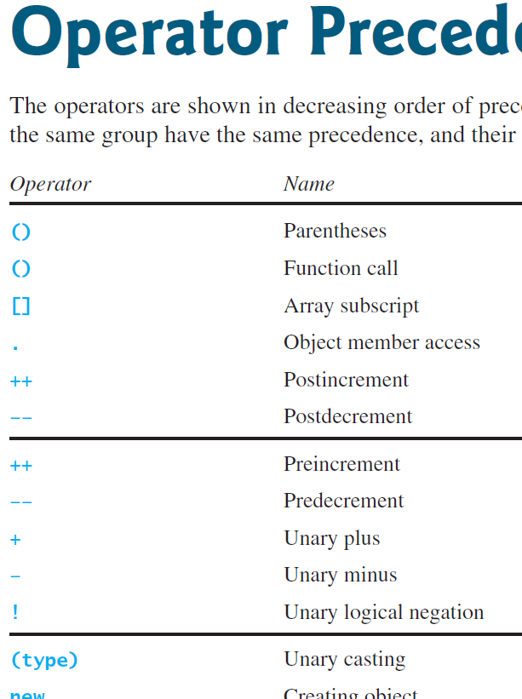

Slide 92
Operator Precedence and Associativity
The expression in the parentheses is evaluated first. (Parentheses can be nested, in which case the expression in the inner parentheses is executed first.) When evaluating an expression without parentheses, the operators are applied according to the precedence rule and the associativity rule.
If operators with the same precedence are next to each other, their associativity determines the order of evaluation. All binary operators except assignment operators are left-associative.

Slide 93
Operator Associativity
When two operators with the same precedence are evaluated, the associativity of the operators determines the order of evaluation. All binary operators except assignment operators are left-associative.
a – b + c – d is equivalent to ((a – b) + c) – d
Assignment operators are right-associative. Therefore, the expression
a = b += c = 5 is equivalent to a = (b += (c = 5))

Slide 94
Example
Applying the operator precedence and associativity rule, the expression 3 + 4 * 4 > 5 * (4 + 3) - 1 is evaluated as follows:

Slide 95
Operand Evaluation Order
Companion Website
Supplement III.A, “Advanced discussions on how an expression is evaluated in the JVM.”

Slide 96
☑ Check Point
List the precedence order of the Boolean operators.
Evaluate the following expressions: true || true && false true && true || false
True or false? All the binary operators except = are left associative.
<--- ANSWER --->
The precedence order for boolean operators is !, ^, &&, and ||
true || true && false is true true && true || false is true
True

Slide 97
☑ Check Point
Evaluate the following expressions: 2 * 2 - 3 > 2 && 4 - 2 > 5 2 * 2 - 3 > 2 || 4 - 2 > 5
<--- ANSWER --->
Both are false

Slide 98
Debugging
Logic errors are called bugs. The process of finding and correcting errors is called debugging. A common approach to debugging is to use a combination of methods to narrow down to the part of the program where the bug is located. You can hand-trace the program (i.e., catch errors by reading the program), or you can insert print statements in order to show the values of the variables or the execution flow of the program. This approach might work for a short, simple program. But for a large, complex program, the most effective approach for debugging is to use a debugger utility.

Slide 99
Debugger
Debugger is a program that facilitates debugging. You can use a debugger to
Execute a single statement at a time.
Trace into or stepping over a method.
Set breakpoints.
Display variables.
Display call stack.
Modify variables.

Slide 100
Debugging in NetBeans
Companion Website
Supplement II.E, Learning Java Effectively with NetBeans

Slide 101
Debugging in Eclipse
Companion Website
Supplement II.G, Learning Java Effectively with Eclipse

